Slide 1
SAGE
Desktop automation Assistant
BALASORE COLLEGE OF ENGINEERING &TECHNOLOGY
Department of CSE & IT

Slide 2
OUR TEAM
Dibyajyoti Ash
Swetleena Mallick

Slide 3
CONTENT
Introduction
Overview
Key Features
User Experience
Technology
Comand Flow Diagrams
Sample Interaction Sequence
Architecture
Performance Optimization
Future Enhancements
Conclusion

Slide 4
ABSTRACT
The project aims to address limitations in traditional voice assistants, such as limited desktop control, lack of automation, and high internet dependency, by providing offline functionality, deep system integration, and multi-modal interaction. Sage can open and close applications, control system functions, extract text from images, search the web, and monitor system resources.

Slide 5
INTRODUCTION
Sage is an intelligent assistant that understands natural language and automates a variety of desktop tasks. It leverages advanced NLP and robust automation tools to streamline your digital workflow, making everyday tasks more efficient and enjoyable.

Slide 6
OVERVIEW
Sage is a comprehensive voice assistant designed as a unified, single-class solution for seamless voice interaction. The system greets users, listens for commands through a dedicated microphone, and accurately interprets spoken input using robust regex pattern matching. Commands are efficiently dispatched to appropriate handlers—whether to launch applications, perform web searches, or execute other tasks—while users receive clear, audible feedback via text-to-speech synthesis. Its modular architecture facilitates effortless integration of new commands and functionalities, ensuring ongoing adaptability and scalability.

Slide 7
KEY FEATURES
Speech-to-Text: Accurate voice transcription.
Text-to-Speech: Natural audio responses.
Command Processing: Flexible regex matching.
Desktop Automation: Efficient UI & process control.
Web Interactions: Real-time searches and summaries.

Slide 8
USER EXPERIENCE
Intuitive Interaction: Sage’s natural language interface lets users interact seamlessly without needing to learn complex commands.
Responsive Feedback: Immediate verbal confirmations and on-screen cues ensure users always know what action is being taken.
Accessibility Focus: Designed for hands-free operation, Sage supports users with disabilities and those seeking convenience during multitasking.

Slide 9
TECHNOLOGY
Python-Based: Core development using Python for rapid prototyping and extensive library support.
Speech & Audio: Utilizes `speech_recognition` for voice input and `pyttsx3` for natural-sounding TTS.
Desktop Automation: Integrates `pyautogui`, `pywinauto`, and `win32com.client` to control applications and windows.
API Integrations: Connects to YouTube (via Google API), Wikipedia, and web search services for dynamic data retrieval.
OCR & Image Processing: Implements `pytesseract` with PIL to extract and process text from screen captures.
System Control & Performance: Uses OS commands and `psutil` for resource management and system-level operations. slides and distilled the core components relevant to a Python-based voice assistant into a clear, bullet-point format for an impactful presentation.

Slide 10
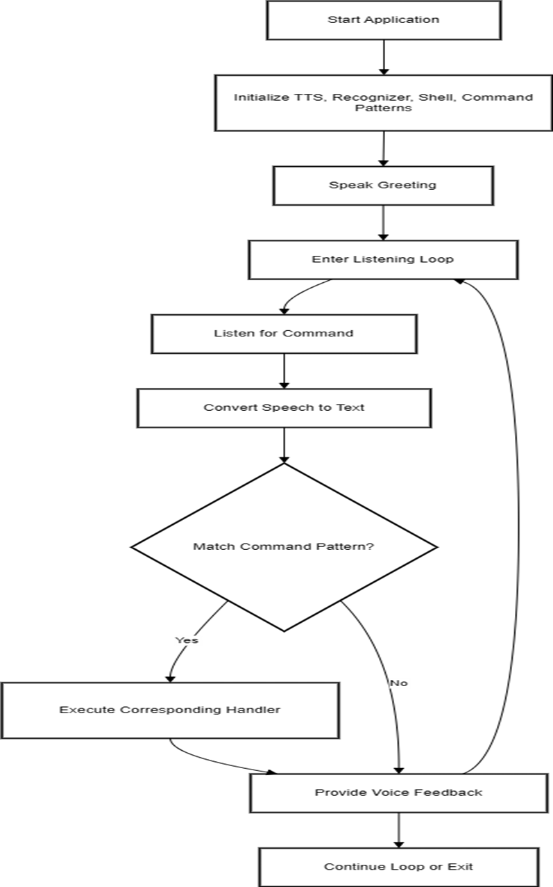
COMAND FLOW DIAGRAM

Slide 11
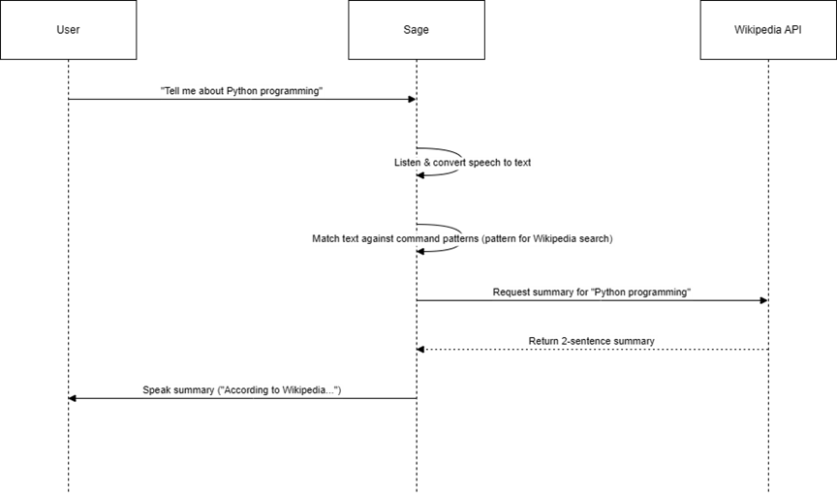
SAMPLE INTERACTION SEQUENCE

Slide 12
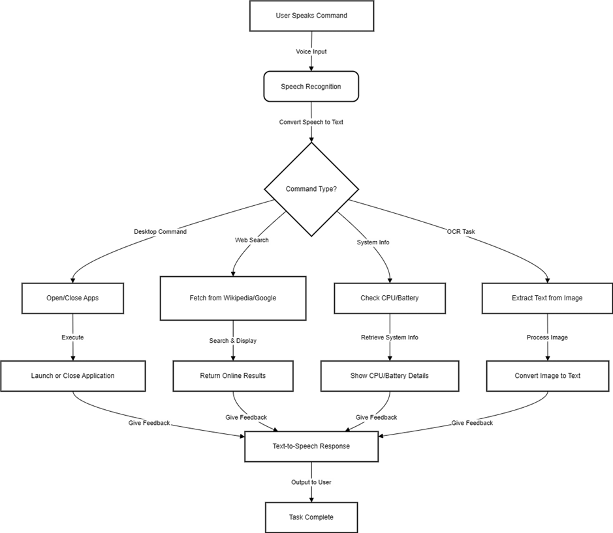
LOGIC DIAGRAM

Slide 13
SYSTEM ARCHITECTURE
Initialization:
Set up TTS engine, speech recognizer, and command patterns.
User Interaction Loop:
Greet user and capture voice input.
Convert input to lowercase and match against registered commands.
Execute the corresponding handler and provide audible feedback.
Continuous Operation:
Loop persists until an exit command is received.
This streamlined design ensures effective user interaction, accurate command recognition, and a natural conversational flow.

Slide 14
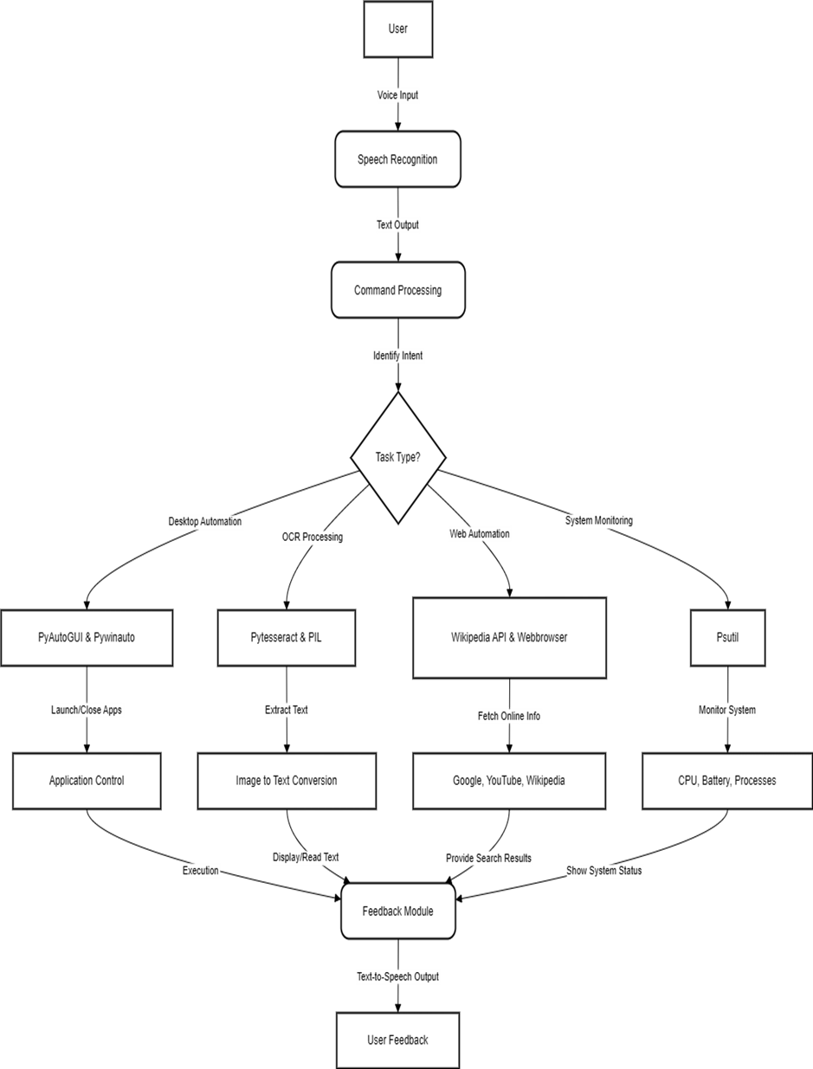
SYSTEM ARCHITECTURE

Slide 15
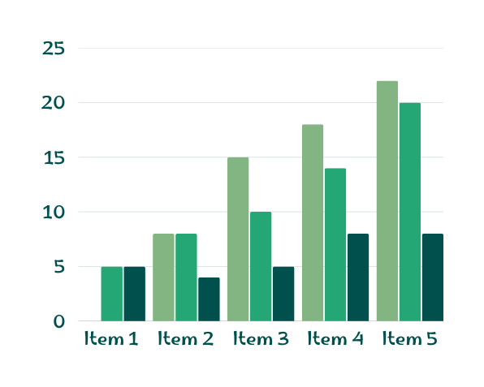
PERFORMANCE OPTIMIZATION
Efficient Command Matching: Optimized regex patterns for quick command identification.
Multi-threading: Asynchronous processing for smooth, responsive interactions.
Resource Management: Effective logging, error handling, and system monitoring (e.g., psutil).
Profiling & Testing: Continuous performance tuning to ensure low latency.

Slide 16
FUTURE ENHANCEMENTS
Advanced NLP:
Integrate machine learning for deeper context and intent recognition.
Expanded Integrations:
Connect with additional APIs, smart devices, and third-party services.
Enhanced Personalization:
Enable customizable commands and adaptive user interfaces.
Improved Security:
Strengthen authentication and error recovery mechanisms.
User Feedback Loop:
Leverage analytics and user insights for continuous improvement.

Slide 17
CONCLUSION
Sage is a cutting-edge voice assistant that redefines user interaction by seamlessly integrating speech recognition, text-to-speech, and automation. Its robust, modular design not only ensures efficient desktop control and intuitive feedback but also lays the groundwork for continuous improvement and future innovation based on user insights and emerging technologies.

Slide 18
THANK
YOU

